Slide 1

Artket: Research on Needfinding
Yong Seok (tommy) lee, Duc minh dao

Slide 2
Developer Team : MicroGoo
Members:
Yong Seok (Tommy) Lee
Duc Minh Dao

Slide 3
Customer : Entropy Software
Product : Artket

Slide 4
Interview Questions
What are the main things you look for when you purchase artworks online? For example, do you look at the name of the artist?
What filters do you use most frequently to filter out artworks?
How do you identify artworks you want to purchase?
What are some things you found uncomfortable when buying them online?
Could you outline the process you take when buying artworks online?

Slide 5
Common Themes in Interview Responses
Price and Category/Tags are the filters that people consider most important
The process for purchasing artworks is similar across most people: keep filtering out artworks until one is chosen
-Thus, filters are extremely important when examining artwork

Slide 6
Need
insight
Appropriate and effective filters to help identify the artworks that they want more easily
There is such a thing as “too many filters”. Preferably, limit the filters and allow the users to browse the artworks

Slide 7
Need
insight
User-Friendly interface that does not disrupt the user’s goals
Things that benefit the user (e.g. discount code pop-ups) can serve as a hindrance to the user’s goal

Slide 8
Idea to Consider: Minimalism in Design
Clean and minimalistic design to emulate the feel of an online website for art

Slide 9
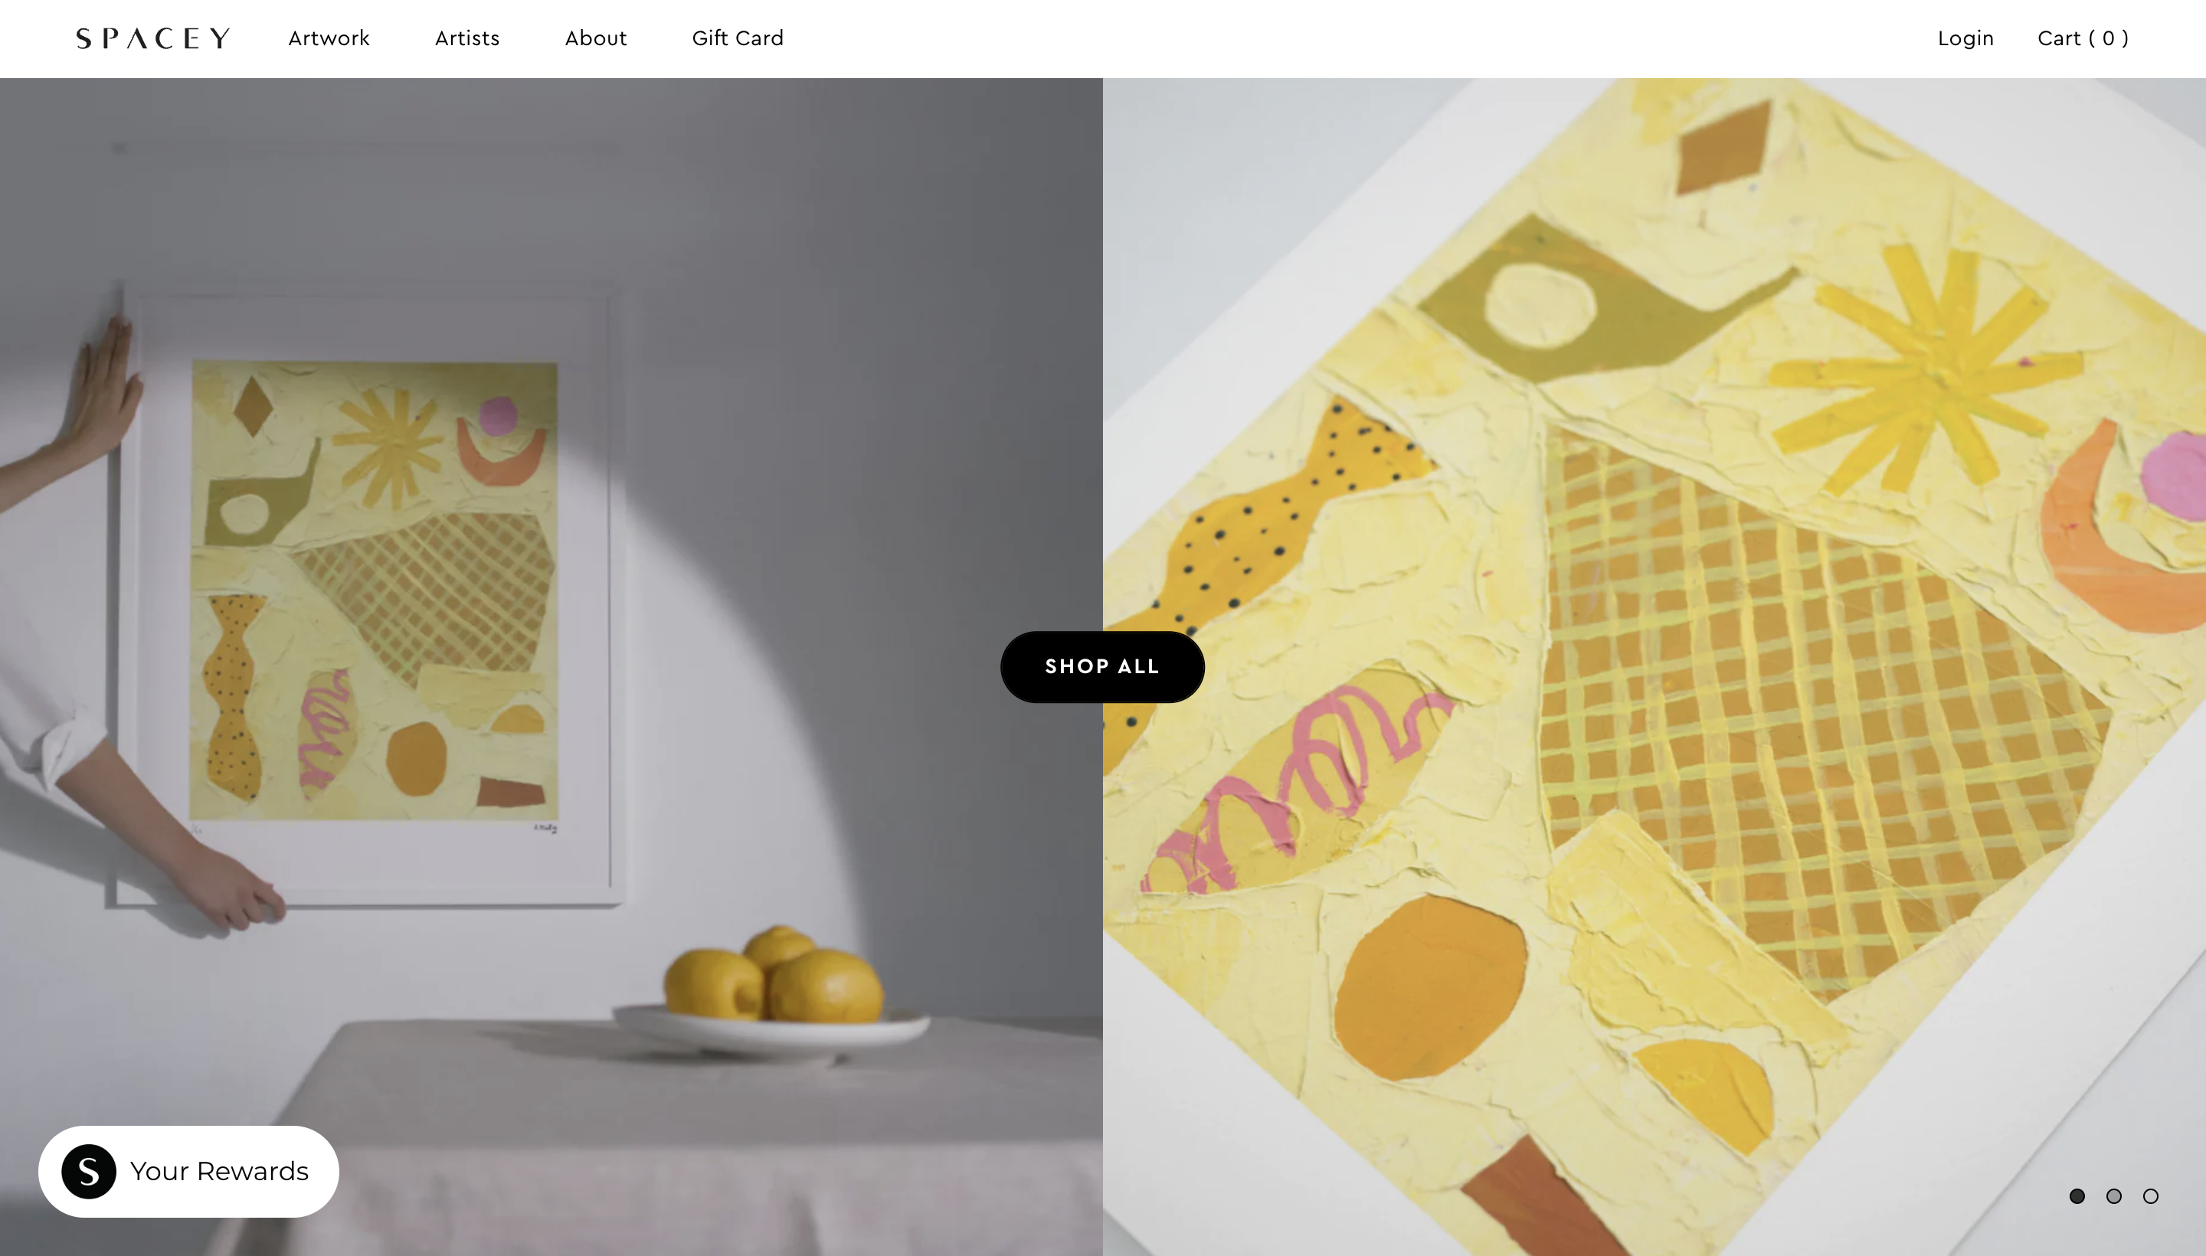
Example

Slide 10
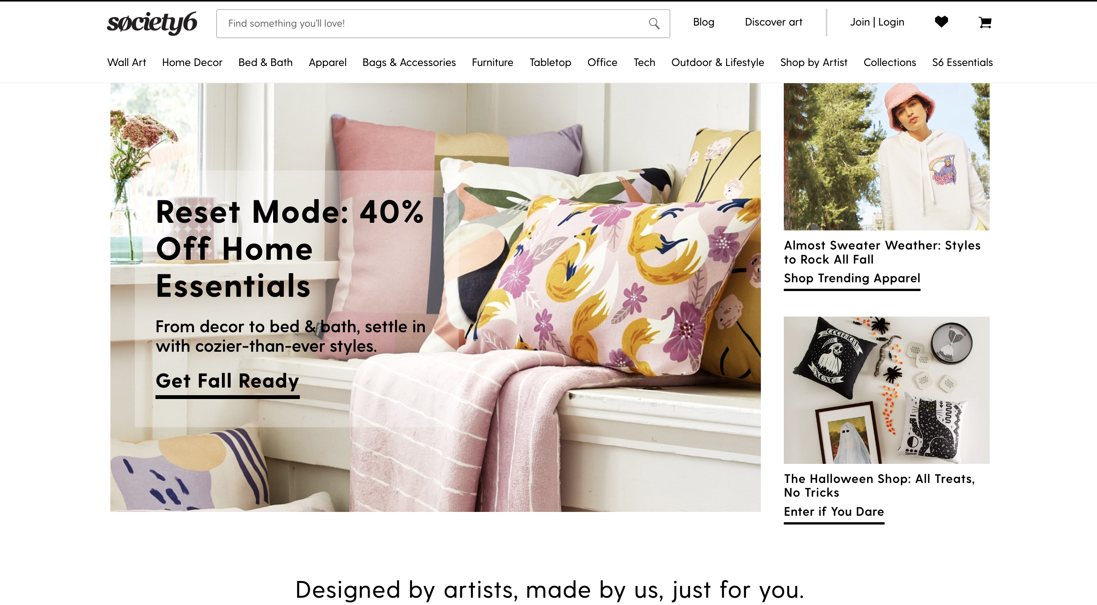
Counter Example

Slide 11
Idea to Consider: Minimalism in Design
Grouping only the most commonly used filters together to avoid overwhelming the users with information
“Personally, I think having too many options is uncomfortable” – one of our interviewees

Slide 12
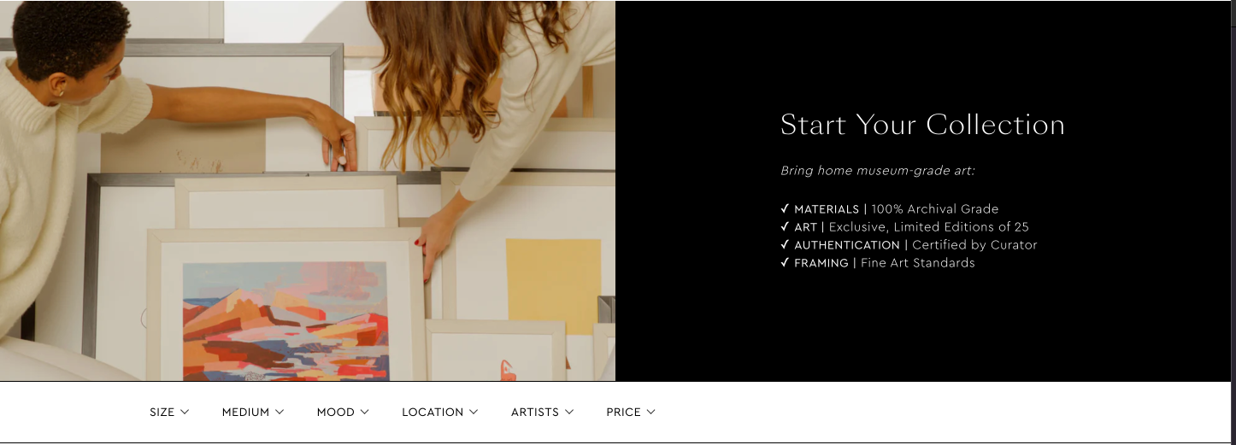
Example

Slide 13
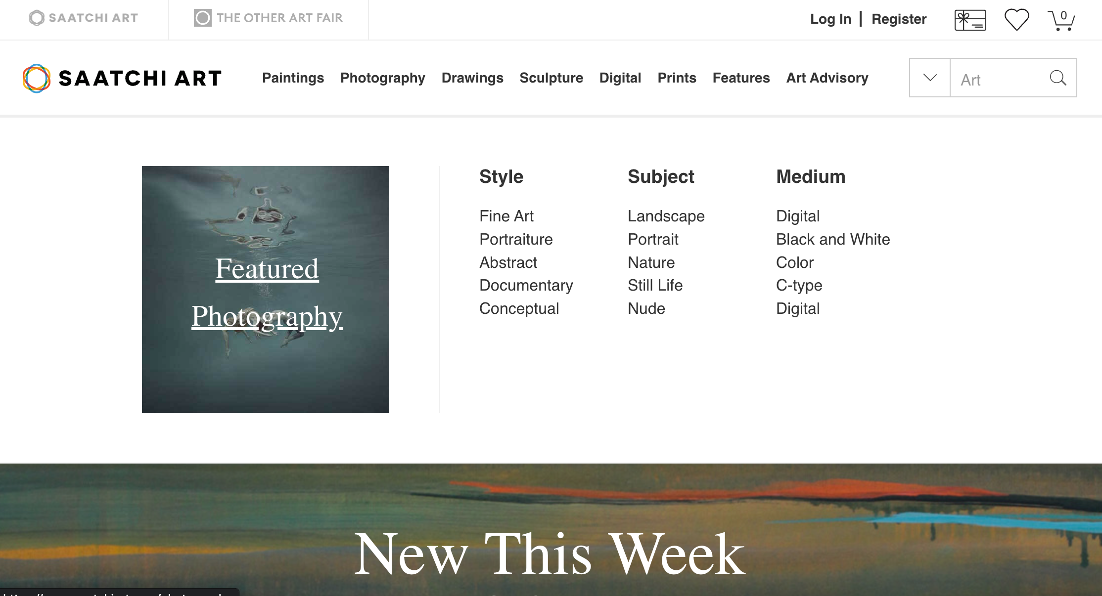
Counter Example

